Slide 2
Digraphs and Relations
Directed graphs
Adjacency
Out-degree and In-degree
Directed Paths and Directed Cycles

Slide 3
What is a digraph?
Short for a “Directed Graph".
A digraph is comprised of vertices and edge (common to all area of graph theory, but edges are directed - often indicated with arrows)
Digraphs are very useful for visualizing relations.
Very useful for a variety of IT applications (e.g. multistate process (behaviour of AI player) and project management).

Slide 4
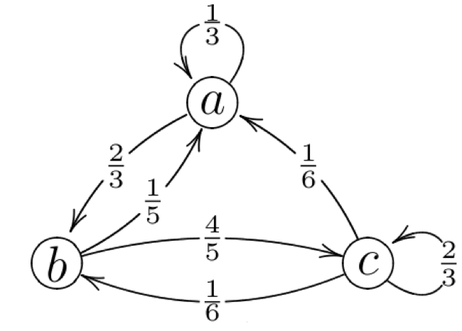
Example of a Digraph

Slide 5
What is a relation?
A "relation" is just a relationship between sets of information.
Useful for mathematically expressing behaviour and interaction of AI players in computer games.

Slide 6
Formal Definition of a Relation
Let S be a set, which includes the elements x and y.
A relation R on S is a rule which compares any two elements of the set S
The relation tells us either that x is related to y or that x is not related to y.
We write xRy to mean “x is related to y under the relation R”.

Slide 7
Relations
A relation R on set S is a rule which compares any two elements (x and y) of S and tell us whether or not x and y are related.
Notation: xRy : x is related to y under relation R

Slide 8
Functions and Relations
The use of the term "relation" is often used to refer to binary relations, where the set of all the starting points is called the domain and the set of the ending points is the range.
An example for such a relation might be a function.

Slide 9
Types of Relations
Relations can be reflexive. One example of a reflexive relation is "is equal to". X "is equal to" X.
Relations can be symmetric. One example of a symmetric relation is again "is equal to". If X "is equal to" Y, then we can say Y "is equal to" X.
Relations can be transitive. One example of a transitive relation is "smaller-than". If X "is smaller than" Y, and Y is "smaller than" Z, then X "is smaller than" Z.

Slide 10
Types of Relations
Let R be a relation defined on a set S.
We say that R is:
reflexive if for all x ∈ S, we have xRx.
symmetric if for all x, y ∈ S such that xRy, we have yRx.
transitive if for all x, y, z ∈ S such that xRy and yRz, we have xRz.

Slide 11
Neighbours
Discuss whether or not the following relations are reflexive, symmetric and transitive.
.... is a next door neighbour of....
.... is a neighbour of....
.... lives on the same street as.....
Name | Address
Ann | No. 1 O’Brien St
Barry | No. 2 O’Brien St
Colm | No. 3 O’Brien St
Deirdre | No. 4 O’Brien St

Slide 12
Relations Example
In a tournament with four players A, B, C, D every player plays
every other player exactly once, although B and D have not
played each other yet. The results are as follows:
A beats B and C
B beats C
D beats A and C.
Draw a digraph to model this information. Explain what the
vertices of the digraph represent and what an arc from one
vertex to another represents.

Slide 13
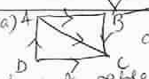
Digraph

Slide 14
Relations Example
R is the relation represented by this digraph.
Determine whether or not R is reﬂexive, symmetric or transitive.

Slide 15
Relations
Vertices represent the players. Edges from one
vertex to another indicate whether or not they
have beaten each other.
Reflexive – No. no player beats themselves
Symmetric – No. Only one player can win a game
Transitive – No. Matches are independent. Also B may still beat D.

Slide 16
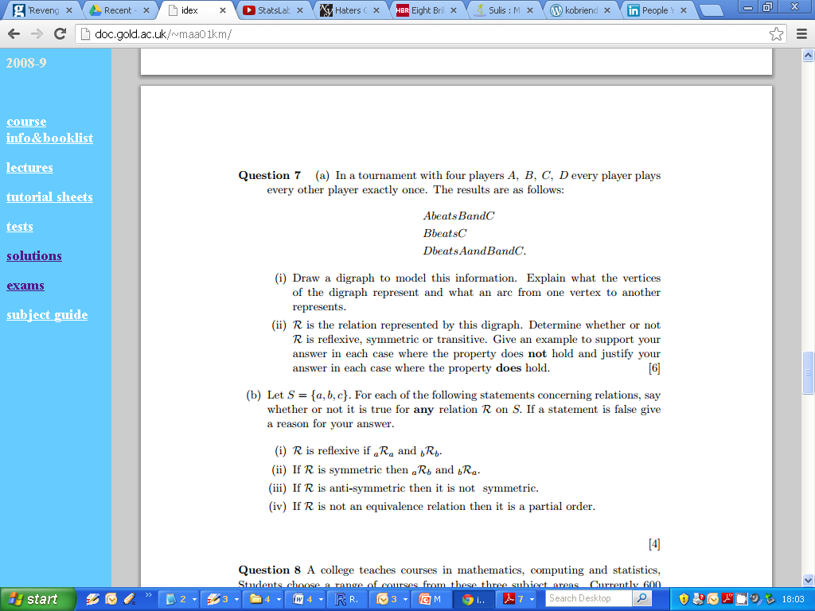
Tournament Example : Digraph

Slide 17
Tournament Example : Digraph

Slide 18
Equivalence Relations
Let R be a relation defined on a set S.
R is reflexive : If for all x ∈ S, we have xRx

Slide 19
Equivalence Relations
Let R be a relation defined on a set S.
R is symmetric : If for all x,y ∈ S, such that if we have xRy, we have yRx.

Slide 20
Equivalence Relations
Let R be a relation defined on a set S.
R is transitive : If for all x,y,z ∈ S, we have xRy and yRz, we have xRz.

Slide 21
Tournament Example

Slide 22
Tournament Example
Reflexive
Symmetric
Transitive

Slide 23
Consider the set A = {1,2,3} and the relation: R = {(1,1), (1,2), (2,1),(2,3)}. We draw the digraph and matrix of the relation.

Slide 24
Relations
Consider the set A = {1,2,3} and the relation: R = {(1,1), (1,2), (2,1),(2,3)}. We draw the digraph and matrix of the relation.
R is not reflexive since 2 is not related to 2. We can interpret the digraph by seeing that there is no arc of length 1 from 2 to 2. Similarly, the 2-2 entry in the matrix is 0.

Slide 25
Relations
Consider the set A = {1,2,3} and the relation: R = {(1,1), (1,2), (2,1),(2,3)}. We draw the digraph and matrix of the relation.
R is not reflexive since 2 is not related to 2. We can interpret the digraph by seeing that there is no arc of length 1 from 2 to 2. Similarly, the 2-2 entry in the matrix is 0.
R is not symmetric since 2 is related to 3, but 3 is not related to 2. Relate this to digraph and symmetric matrix.

Slide 26
Relations
Consider the set A = {1,2,3} and the relation: R = {(1,1), (1,2), (2,1),(2,3)}. We draw the digraph and matrix of the relation.
R is not reflexive since 2 is not related to 2. We can interpret the digraph by seeing that there is no arc of length 1 from 2 to 2. Similarly, the 2-2 entry in the matrix is 0.
R is not symmetric since 2 is related to 3, but 3 is not related to 2. Relate this to digraph and symmetric matrix.
R is not transitive since 1 R 2 and 2 R 3, but 1 is not related to 3. We must check each pair of points. The matrix way is not discussed here.
R is not antisymmetric since 1 R 2 and 2 R 1, but 1 is not equal to 2. Thus there should be no double arcs in the digraph of an antisymmetric relation.

Slide 27
Relations
Consider the set A = {1,2,3} and the relation: R = {(1,1), (1,2), (2,1),(2,3)}. We draw the digraph and matrix of the relation.
R is not reflexive since 2 is not related to 2. We can interpret the digraph by seeing that there is no arc of length 1 from 2 to 2. Similarly, the 2-2 entry in the matrix is 0.
R is not symmetric since 2 is related to 3, but 3 is not related to 2. Relate this to digraph and symmetric matrix.
R is not transitive since 1 R 2 and 2 R 3, but 1 is not related to 3. We must check each pair of points. The matrix way is not discussed here.

Slide 28
Relations
Consider the set A = {1,2,3} and the relation: R = {(1,1), (1,2), (2,1),(2,3)}. We draw the digraph and matrix of the relation.
R is not reflexive since 2 is not related to 2. We can interpret the digraph by seeing that there is no arc of length 1 from 2 to 2. Similarly, the 2-2 entry in the matrix is 0.
R is not symmetric since 2 is related to 3, but 3 is not related to 2. Relate this to digraph and symmetric matrix.
R is not transitive since 1 R 2 and 2 R 3, but 1 is not related to 3. We must check each pair of points. The matrix way is not discussed here.
R is not antisymmetric since 1 R 2 and 2 R 1, but 1 is not equal to 2. Thus there should be no double arcs in the digraph of an antisymmetric relation.

Slide 29
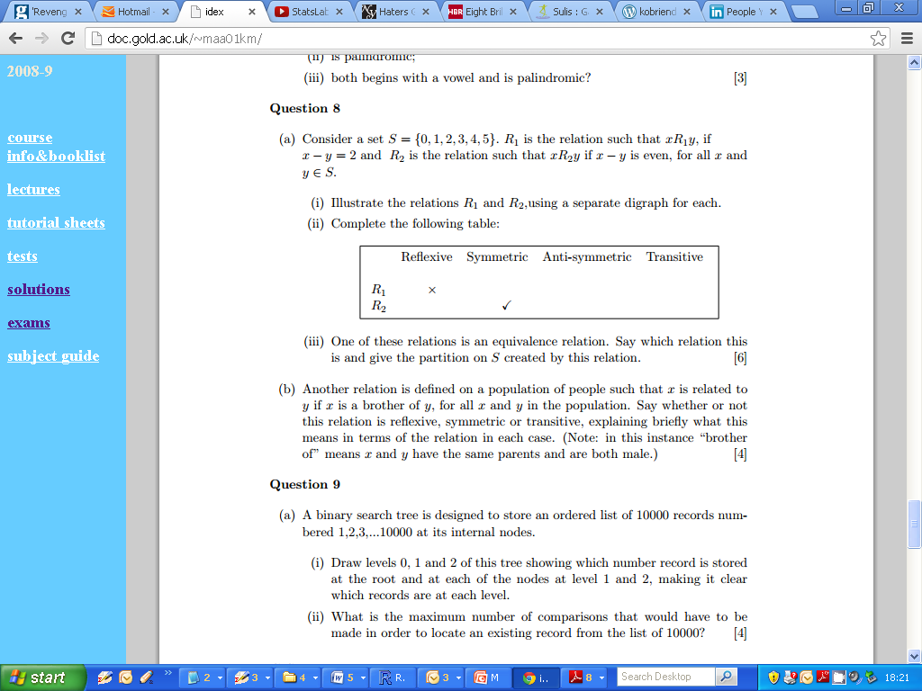
Second Example

Slide 30
Second Example

Slide 31
Second Example

Slide 32

Second Example

Slide 33
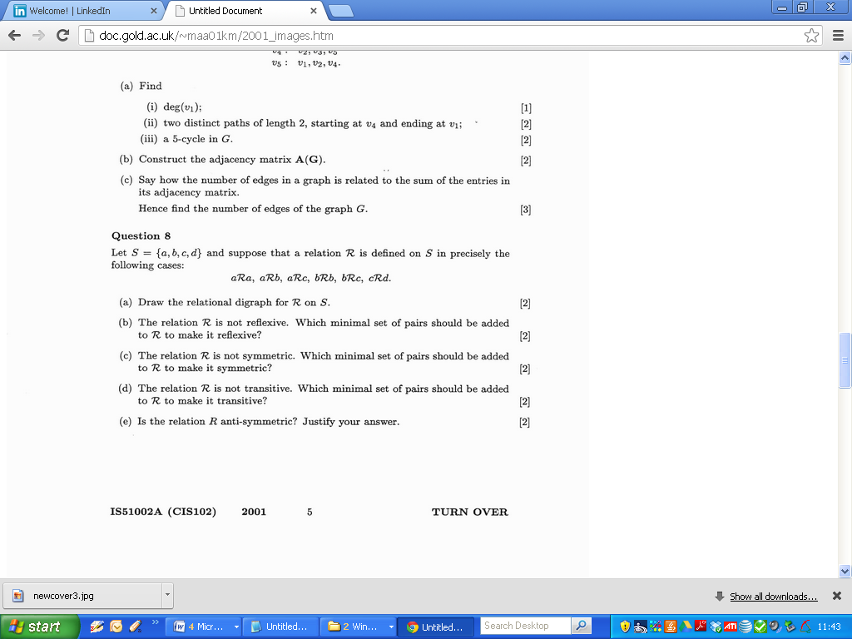
2001

Slide 34
2001

Slide 35
2001

Slide 36
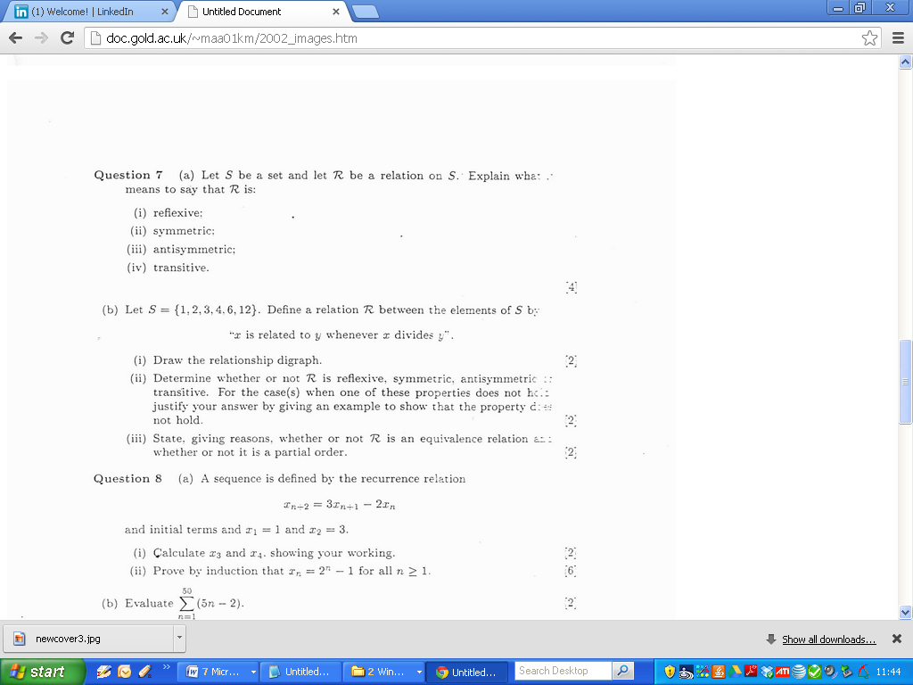
2002

Slide 37
2002

Slide 38
2002

Slide 39
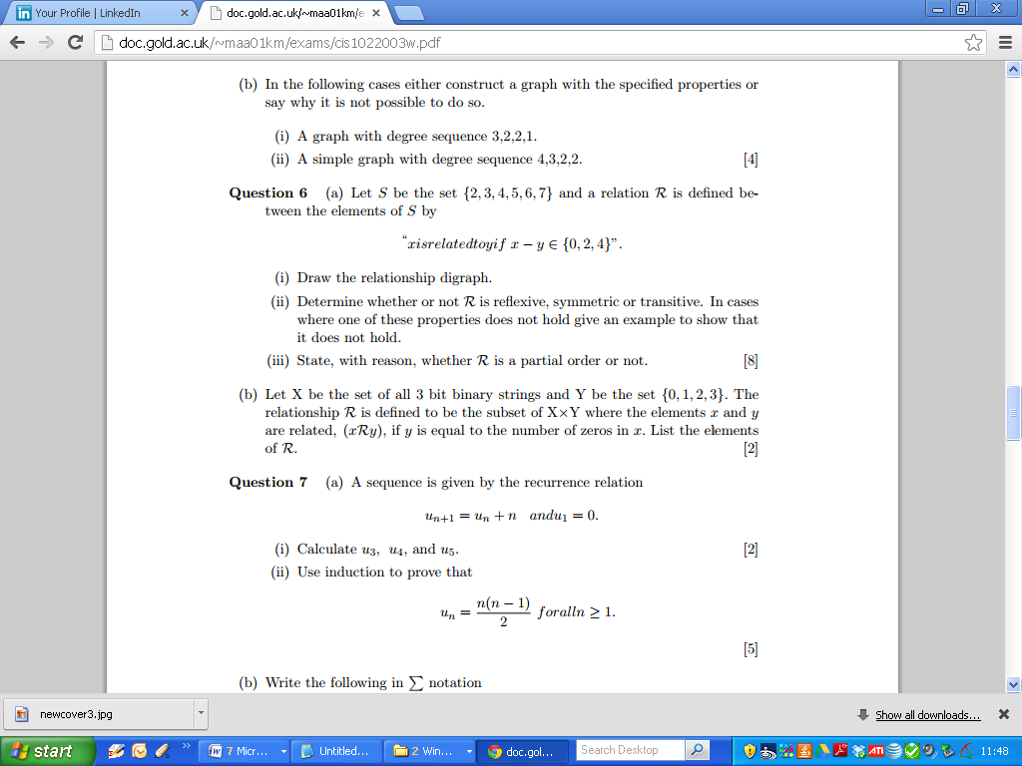
2003

Slide 40
2003

Slide 41
2003

Slide 42
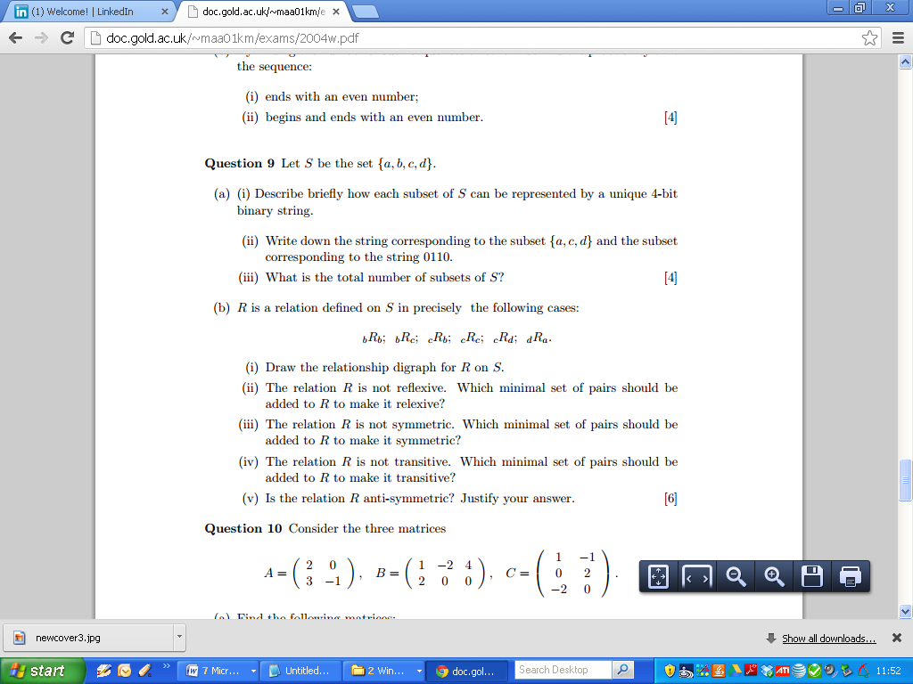
2004

Slide 43
2004

Slide 44
2004

Slide 45
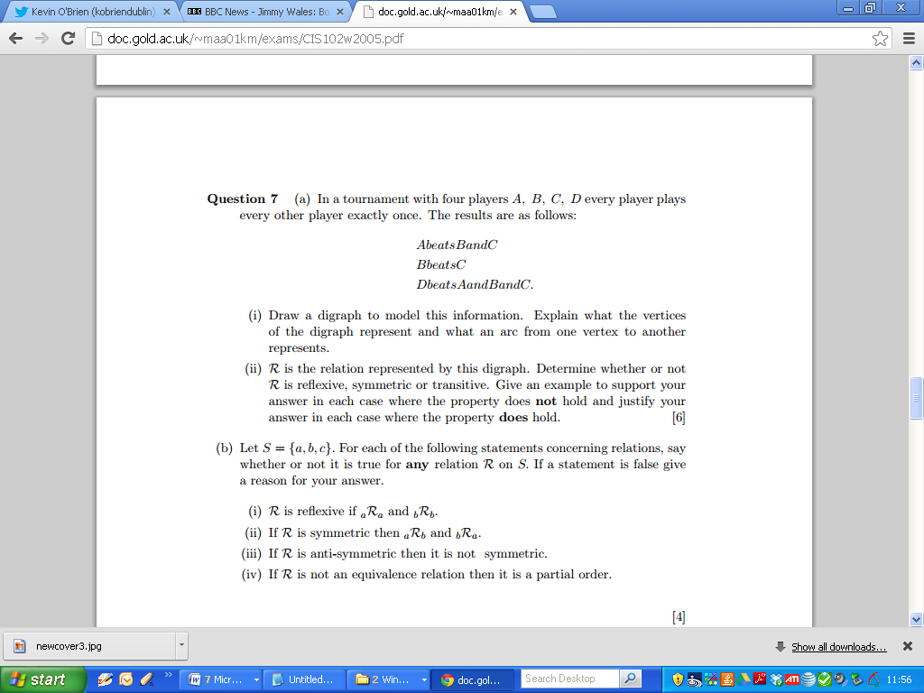
2005

Slide 46
2005

Slide 47
2005

Slide 48
2005

Slide 49
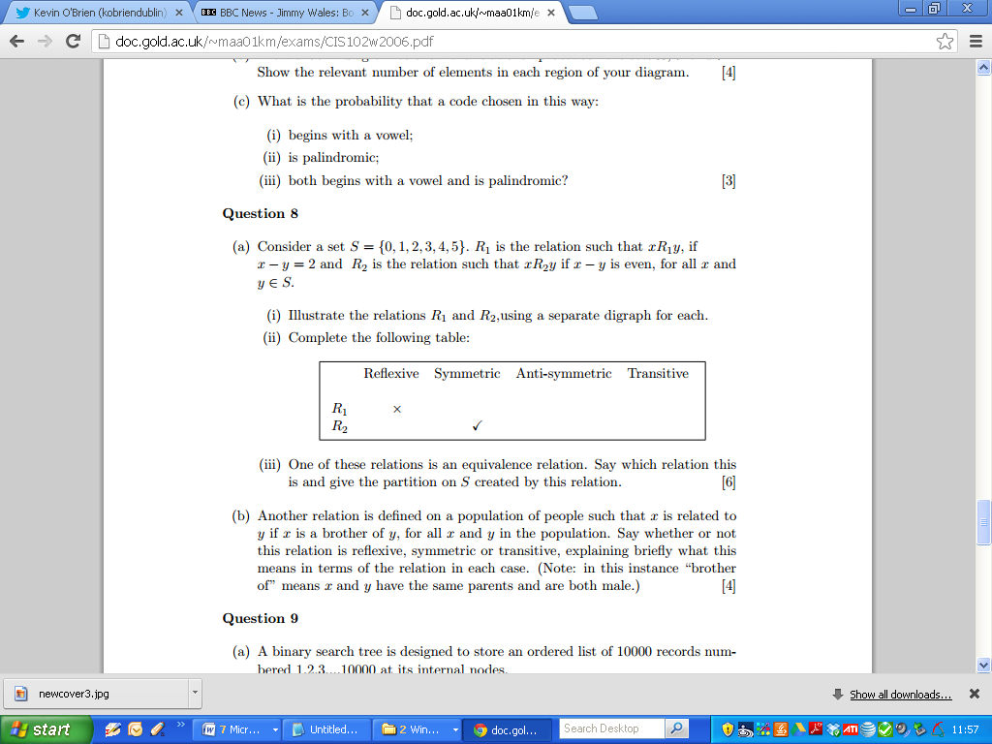
2006

Slide 50
2006

Slide 51
2006

Slide 52
2006

Slide 53
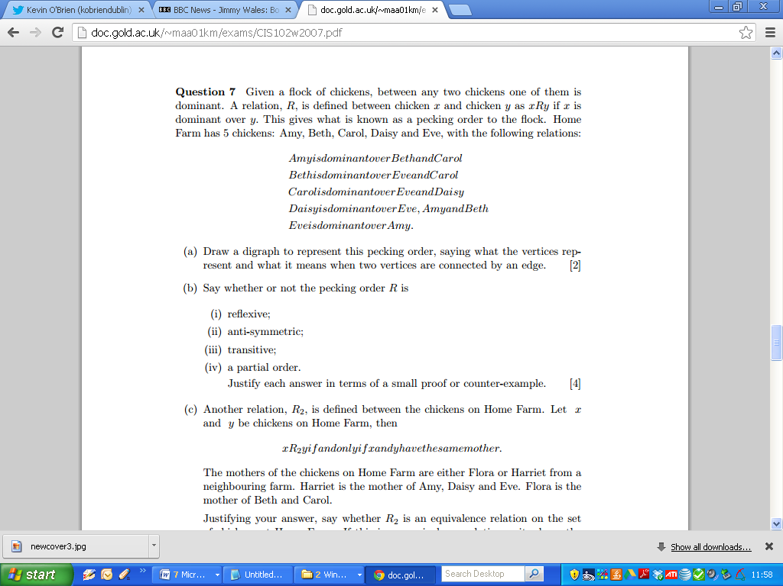
2007

Slide 54
2007

Slide 55
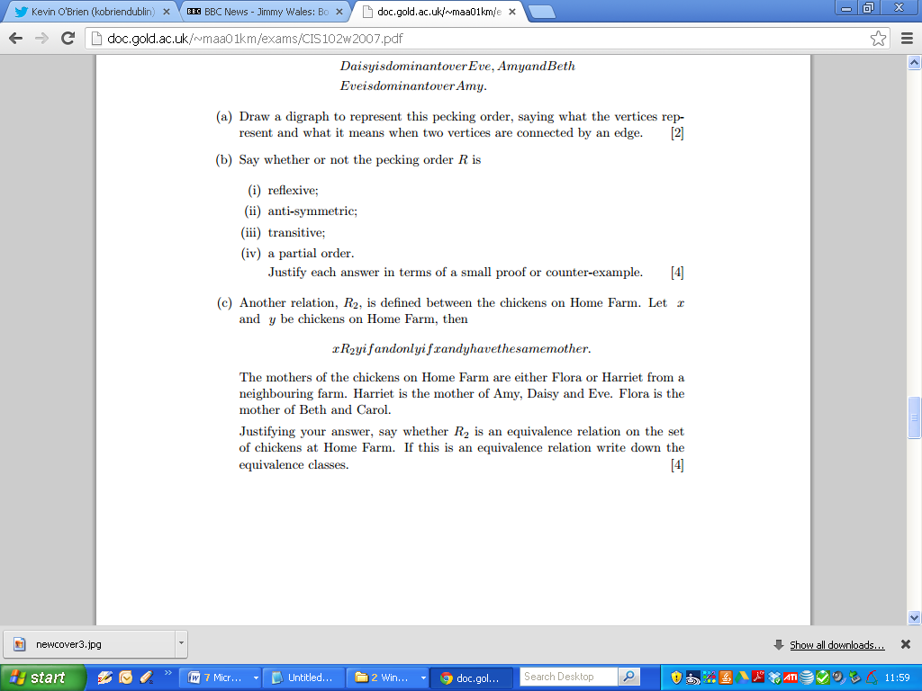
2007

Slide 56
2007

Slide 57
2007

Slide 58
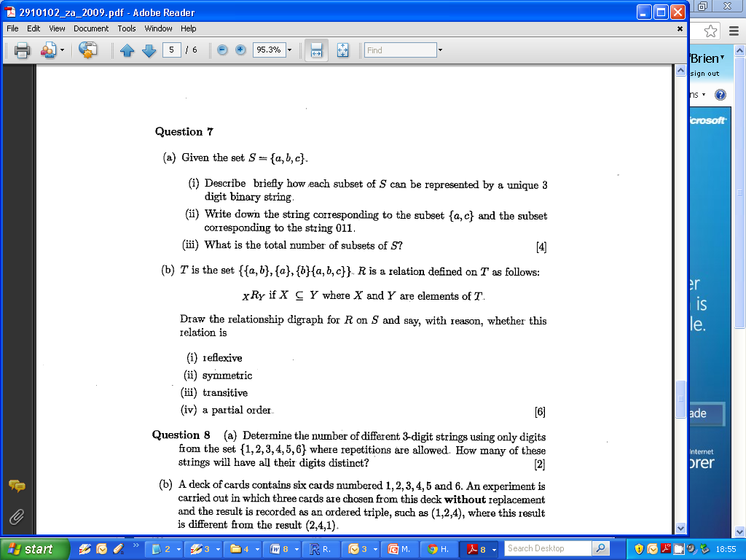
2009 Zone A Q7b

Slide 59
2009 Zone A Q7b
(Digraphs)

Slide 60
2009 Q7
The vertices of the digraph represented sets: {a}, {b}, {a, b} and {a, b, d} and there were directed arcs between vertices when one set was a subset of the other.
Thus there was an arc from {a} to {a, b} and {a, b, d} but not from {a} to {b}.
This relation is reflexive, not symmetric and transitive.
As it is also anti-symmetric it is a partial order.

Slide 61
2009 Zone A Q7b
Anti-Symmetric and Partial Orders
Anti-symmetric: xRy and yRx implies that x=y
Partial Order : Relation is reflexive, anti-symmetric and transitive.

Slide 62
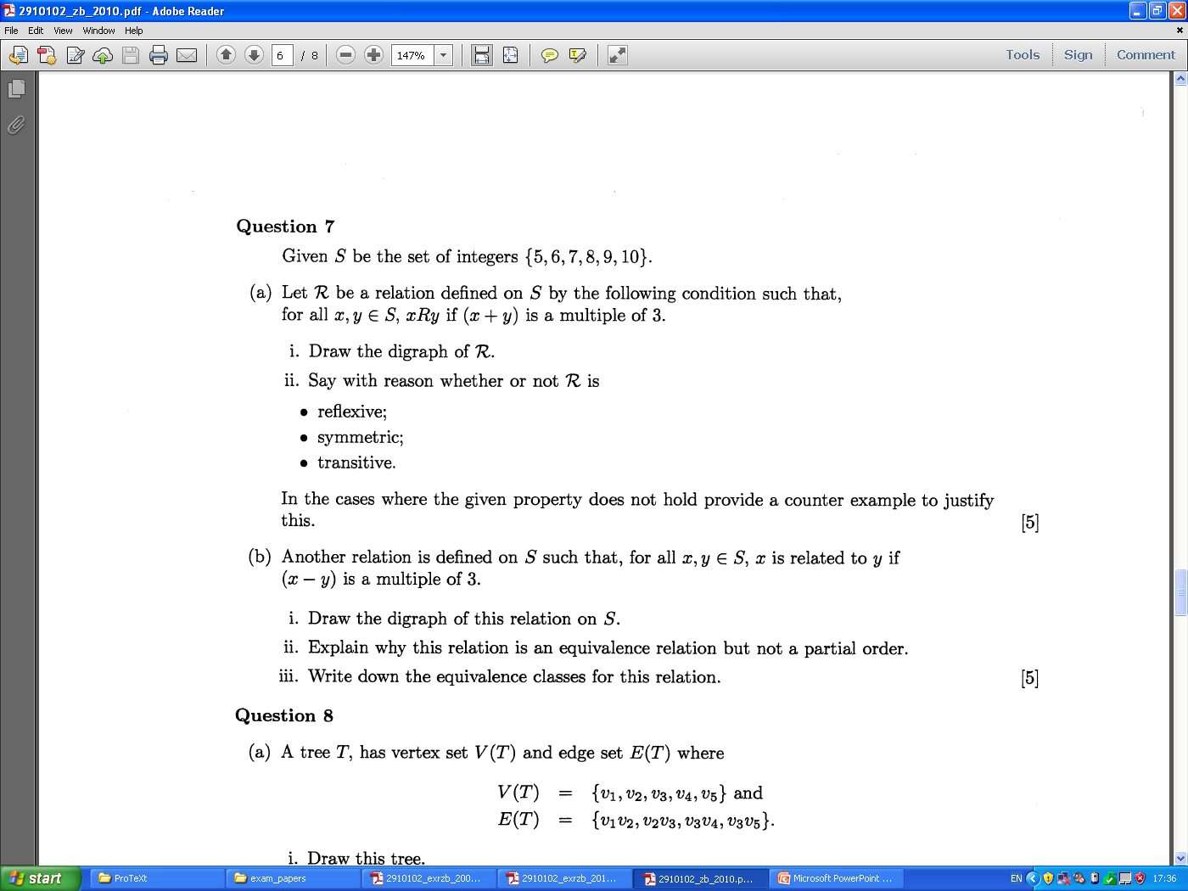
2010

Slide 63
2010

Slide 64
Cartesian Products
Let X and Y be sets. Then the Cartesian product XxY is the set whose elements are all ordered paired of elements (x,y) where x ∈ X and y ∈ Y.
Suppose X = {p,q,r} and Y={a,b,c}
XxY = { (p,a),(p,b),(p,c), YxX
(q,a), (q,b),(q,c),
(r,a),(r,b),(r,c) }

Slide 65
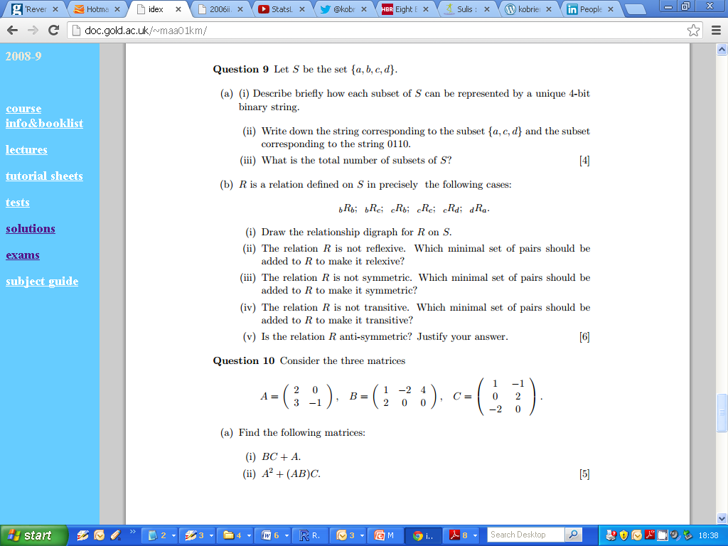
n-bit Binary Strings

